Slide 1
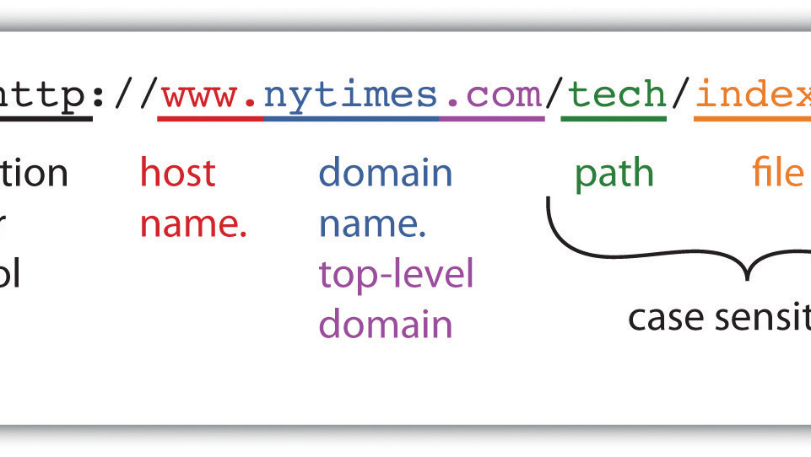
Lecture 4: Domain Names and DNS
Eng / Youssef khaled
Backend Roadmap

Slide 2

What is a Domain Name?
A domain name is the address you type in a browser to visit a website.
It is easier to remember than a series of numbers (IP address).
Example: www.google.com

Slide 3

What is DNS?
DNS (Domain Name System) is like the phone book of the internet.
It translates domain names into IP addresses.
Example: DNS turns www.google.com into 216.58.217.46.

Slide 4

How Does DNS Work?
When you type a domain name, DNS finds the matching IP address.
Your browser uses the IP address to load the website.
Example: DNS finds the IP address for www.example.com and connects you to the server.

Slide 5
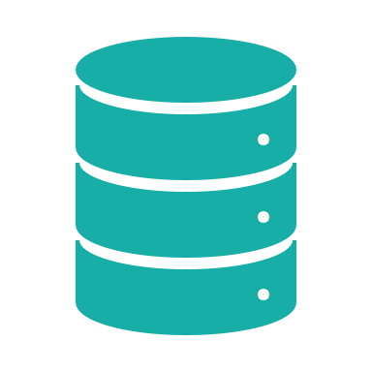
DNS Records
DNS records store information about a domain.
There are different types of records for different purposes.
Examples: A Record, CNAME, MX Record.

Slide 6

A Record
An A Record maps a domain name to an IP address.
It tells browsers where the server for the website is.
Example: www.example.com → 192.168.1.1

Slide 7

CNAME Record
A CNAME (Canonical Name) record forwards one domain to another.
It is used when one website has multiple domains.
Example: www.blog.example.com → www.example.com

Slide 8

MX Record
An MX (Mail Exchange) record tells email systems where to deliver emails for a domain.
It points to the server that handles email.
Example: Emails for @example.com go to the mail server mail.example.com.

Slide 9

How DNS Caching Works
To speed things up, DNS servers and browsers remember (cache) IP addresses.
Next time you visit the same site, DNS may not need to look it up again.
Example: Faster page loading for websites you’ve visited before.

Slide 10

DNS Security
DNS can be vulnerable to attacks, such as DNS spoofing or hijacking.
DNSSEC (DNS Security Extensions) adds security to DNS lookups.
Example: Protecting users from being redirected to fake websites.
ThePhoto by PhotoAuthor is licensed under CCYYSA.

Slide 11

Summary
- DNS translates domain names into IP addresses.
- A Record maps domain to IP, CNAME forwards domains, MX handles emails.
- DNS caching improves speed, and DNSSEC adds security to DNS lookups.

